Slide 1
BIEN 401 Biomedical Mass Transport Class 25 Exam 3 Review
notes prepared by
Dr. Louis Reis
Created on 5/12/2022

Slide 2

Problem 1
An artificial tissue has been created in a laboratory. You know that the cells are all consuming oxygen at the same rate, but you do not know what that rate is. The volume of the tissue is 5 mL. Medium is perfused through the tissue at a flow rate of 1 ml/s, where the concentration of oxygen at the inlet is 140 $μ$M and the concentration at the outlet is 50 $μM$. (A) Determine the value for specific reaction rate $Γ′$. (B) Determine the necessary perfusion rate for the same tissue, but with twice as much volume, and a lower outlet concentration at 20 $μ$M.

Slide 3
Problem 1 Solution

Slide 4
Problem 2
Consider a transdermal caffeine patch. The patch has a surface area of 1 cm² and the patch is 285 μm thick. The patch has an initial caffeine concentration of 1230 mg/mL. The permeability of caffeine through the stratum corneum is 3.28 x 10⁻⁸ cm/s. Caffeine has a molecular weight of 194. Assume there is no caffeine in the body initially and the elimination rate of the caffeine from the body is 0.015 min⁻¹; assume the apparent volume is 15 L.
Assume a 200 μm thick membrane separates the drug in the patch from the skin. The membrane has a porosity of 20% and the pores have radii of 0.6 nm and have a tortuosity factor of 2. Assume the bulk diffusivity of caffeine can be determined using the Renkin-Curry expression (assume the solution is water at 37ºC).
Determine the following:
Diffusivity of caffeine in the bulk fluid (water at 37ºC)
Permeability of caffeine through the patch membrane
Concentration of caffeine in the plasma after 1 hour.

Slide 5
Problem 2 Solution

Slide 6
Problem 2 Solution

Slide 7

Problem 3
A 0.5 cm diameter sphere is coated with glucose and immersed in 37 $°\text{C}$ pure water flowing at a velocity of 1.5 cm/s. The dynamic viscosity of the water is 0.69 cP, and the density of water is 1 g/cm³. Assume that the diffusion coefficient for glucose is $4×{10}^{−6}$ cm²/s, and the equilibrium solubility is 0.91 g/mL.
Determine the following:
The Reynolds, Schmidt, and Sherwood numbers
The mass transfer rate of glucose from the sphere

Slide 8
Problem 3 Solution

Slide 9
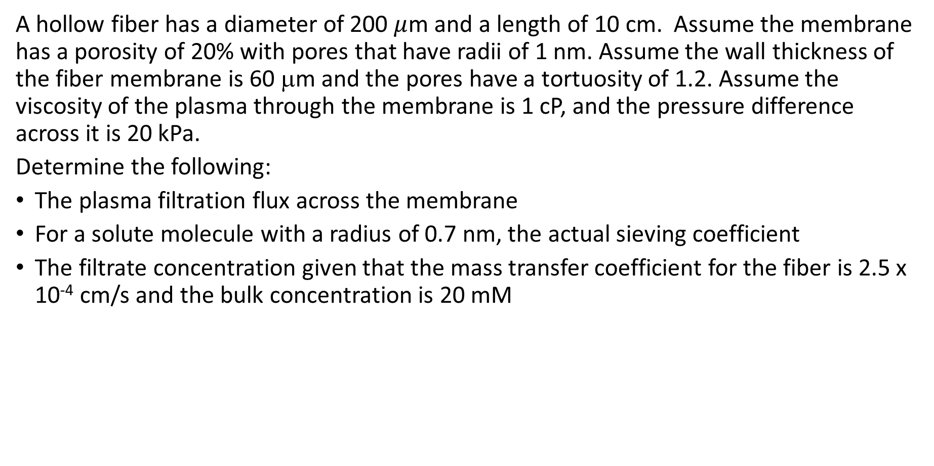
Problem 4
A hollow fiber has a diameter of 200 $μ$m and a length of 10 cm. Assume the membrane has a porosity of 20% with pores that have radii of 1 nm. Assume the wall thickness of the fiber membrane is 60 μm and the pores have a tortuosity of 1.2. Assume the viscosity of the plasma through the membrane is 1 cP, and the pressure difference across it is 20 kPa.
Determine the following:
The plasma filtration flux across the membrane
For a solute molecule with a radius of 0.7 nm, the actual sieving coefficient
The filtrate concentration given that the mass transfer coefficient for the fiber is 2.5 x 10⁻⁴ cm/s and the bulk concentration is 20 mM

Slide 10
Problem 4 Solution

